Slide 1
OUR HIGH PRIEST
Hebrews 7:1-3;11-28

Slide 2
REminder
Hebrews written to Jewish believers
Over 100 references to the Old Testament in Hebrews and 40 direct quotations
Its purpose
To show how Jesus completes and fulfils the basic laws of the Judaism

Slide 3



REminder
It is show how Jesus brings a better and lasting new covenant

Slide 4
REminder
How does this relate to us?
It demonstrates
The importance and completeness of our faith in Jesus

Slide 5
Melchizedek
Who was he?
King of Salem
Priest of God
Not from the tribe of Levi

Slide 6
Melchizedek
Where did he come from?
No origin, no beginning or end (v3)
Melchizedek – “King of Righteousness”
King of Salem – “King of Peace”

Slide 7
ABRAHAM
Genesis 14
Abraham and Lot (his nephew) went separate ways
Lot gets captured and loses everything
Abraham goes to Lot’s rescue
Lot and all his family and possessions are recovered

Slide 8
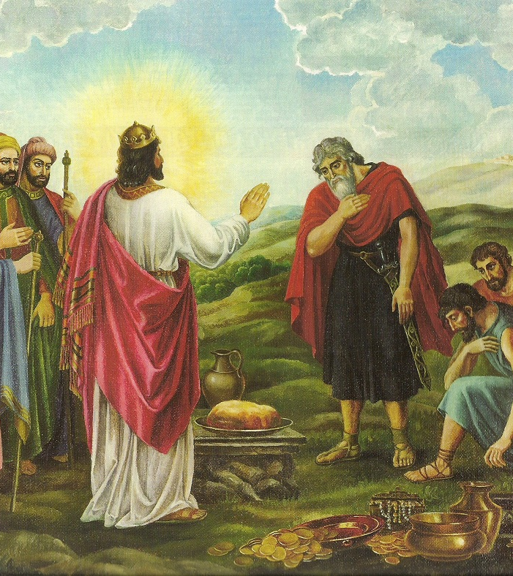
Abraham
Genesis 14
Melchizedek appears on the scene
V18 “King of Salem, a priest of God most high”

Slide 9
ABRAhaM
Genesis 14
Salem can be identified as Jerusalem
Psalm 76:2 “His (God’s) tent is in Salem, his dwelling place in Zion.”

Slide 10
ABRAhaM
Genesis 14
Melchizedek brings bread and wine
Maybe refreshments but also thoughts of communion
Abraham tithes to Melchizedek

Slide 11
Melchizedek
So Melchizedek is Priest and King
Bringing together two roles
Is this not a prefiguring of Jesus?
Jesus is our high priest and the king of kings

Slide 12
Melchizedek
Look at the order
King of Righteousness
King of Peace
Righteousness comes before Peace

Slide 13
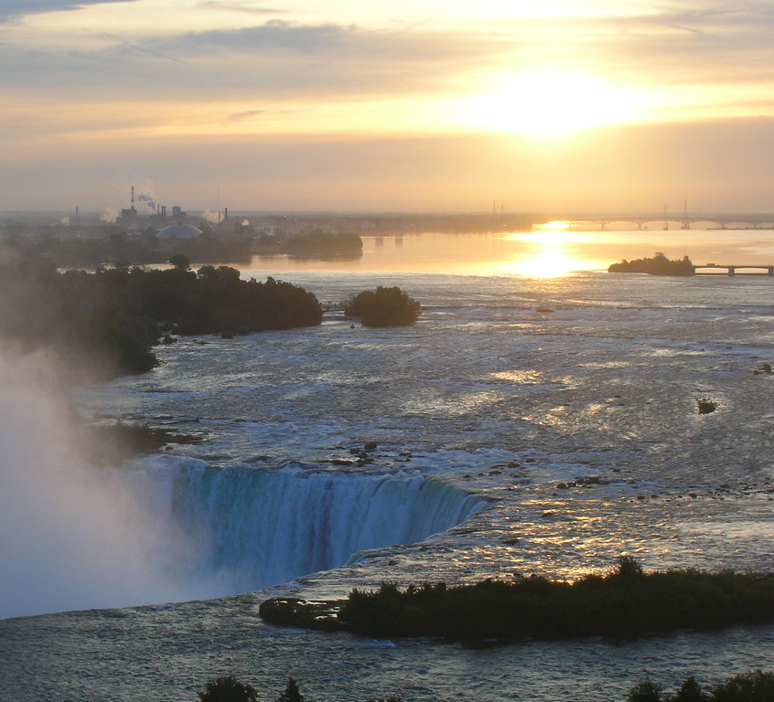
Melchizedek
Righteousness is the path to peace
This Photo by Unknown Author is licensed under CC BY

Slide 14
Spurgeon said “peace without righteousness is like the peaceful waters of the Niagara before it goes over the falls”

Slide 15
People may look for peace
but it won’t last without righteousness
True lasting peace can only come from a heart cleansed by the blood of Jesus

Slide 16
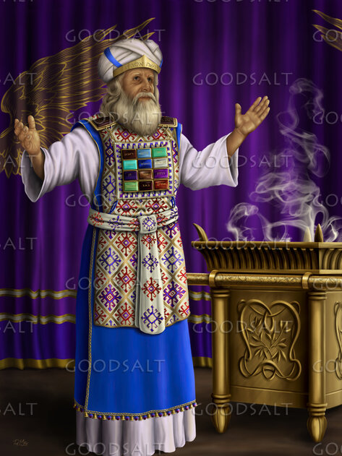
The Jews had to realise that the priesthood was not just Levites
Aaron’s line was limited
This new priesthood was after the order of Melchizedek
Jesus is High Priest for ever

Slide 17
Melchizedek greater than Abraham
Abraham gave a tenth of all he had taken in battle
The lesser gives to the greater
Melchizedek blessed Abraham with the authority of God
Only one who is greater has the power to bless

Slide 18
Melchizedek greater than Levites
Tithes were normally given to Levites
The Levites descended from Abraham
Abraham tithed to Melchizedek so by default Levites tithed to Melchizedek

Slide 19
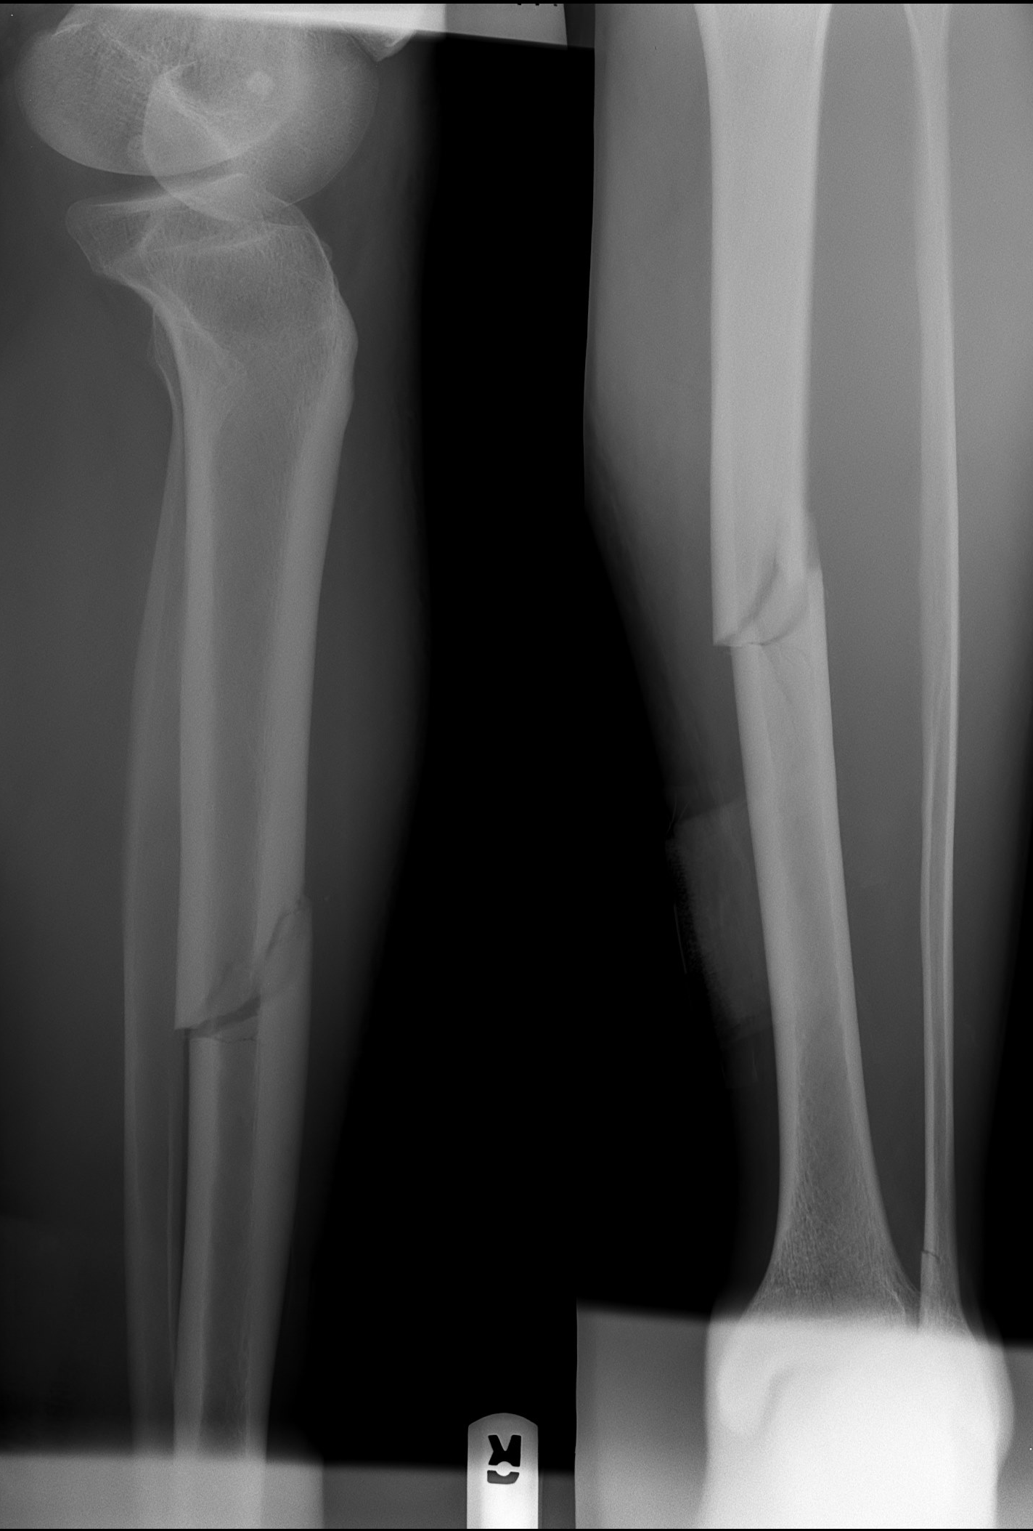
A NEW priesthood
An X ray reveals a broken limb but cannot deal with it
V19 The law made nothing perfect
The law reveals sin but cannot deal with it
This Photo by Unknown Author is licensed under CC BY-SA

Slide 20
A NEW priesthood
The old priesthood of Levi was based on the Law
That was temporary until the perfect sacrifice could be made
Jesus was the perfect sacrifice and deals with the diagnosis of sin revealed by the law

Slide 21
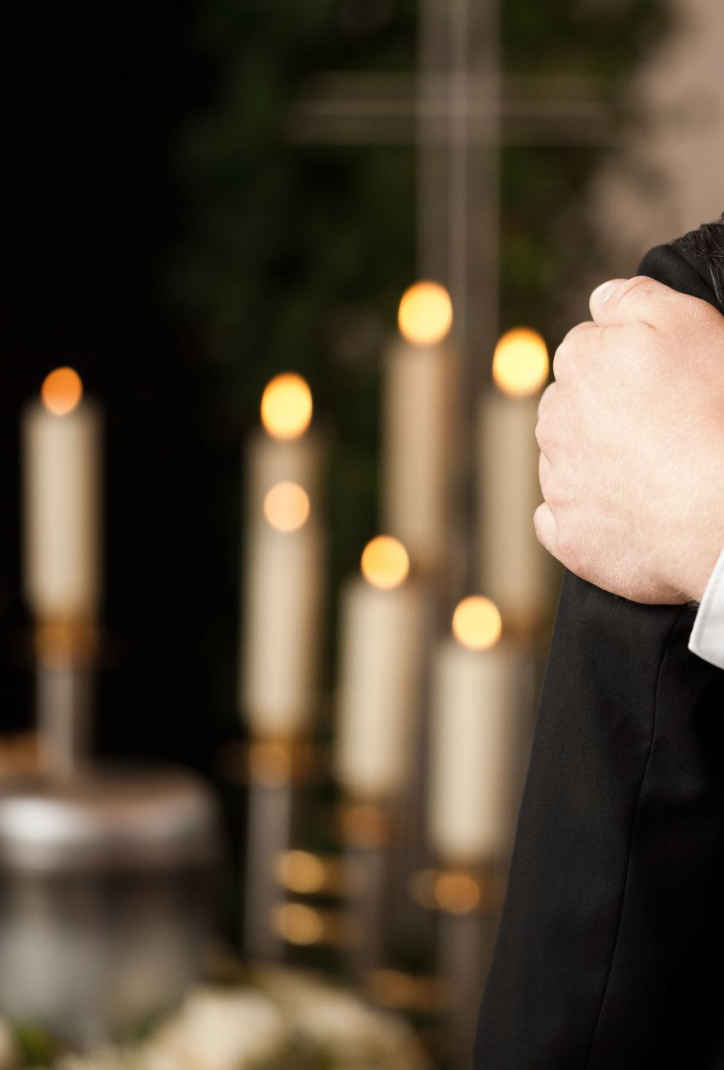
A NEW priesthood
Every High Priest eventually died and was replaced
Now we have a High Priest who lives forever

Slide 22
Psalm 110:4b
David speaking of the coming King (Jesus)
“You are a priest forever in the order of Melchizedek”

Slide 23
A New covenant - agreement
The Levitical High Priest had to offer up sacrifices for himself. Then for the sins of others.
NB It was a Levitical High Priest who put Jesus to death
Jesus was perfect so offered up Himself once for all time for our sins

Slide 24
A New covenant - agreement
Once a year the Levitical high priest would enter the presence of God in the Holy of Holies before the Mercy Seat
Jesus is always in the presence of the Father interceding for us

Slide 25
A New covenant - agreement
If we sin Jesus is pleading our case (1John 2:1)
All we have to do is confess it in total sincerity
“If we confess our sins, He is faithful and just to forgive us our sins and to cleanse us from all unrighteousness.” (1 John 1:9)

Slide 26
A New covenant - agreement
We need to keep short accounts
No need to wait until we can make the right costly sacrifice
What a wonderful salvation (deliverance from the power and effects of sin) we have in Jesus.

Slide 27
A New covenant - agreement
Jesus is not placating an angry Father who wants to destroy us.
It is not a matter of continually chanting prayers on behalf of His people.

Slide 28
A New covenant - agreement
He defends us against Satan’s accusations and attacks.
He represents us before the Father.
Then we can draw near to the Father through Him

Slide 29
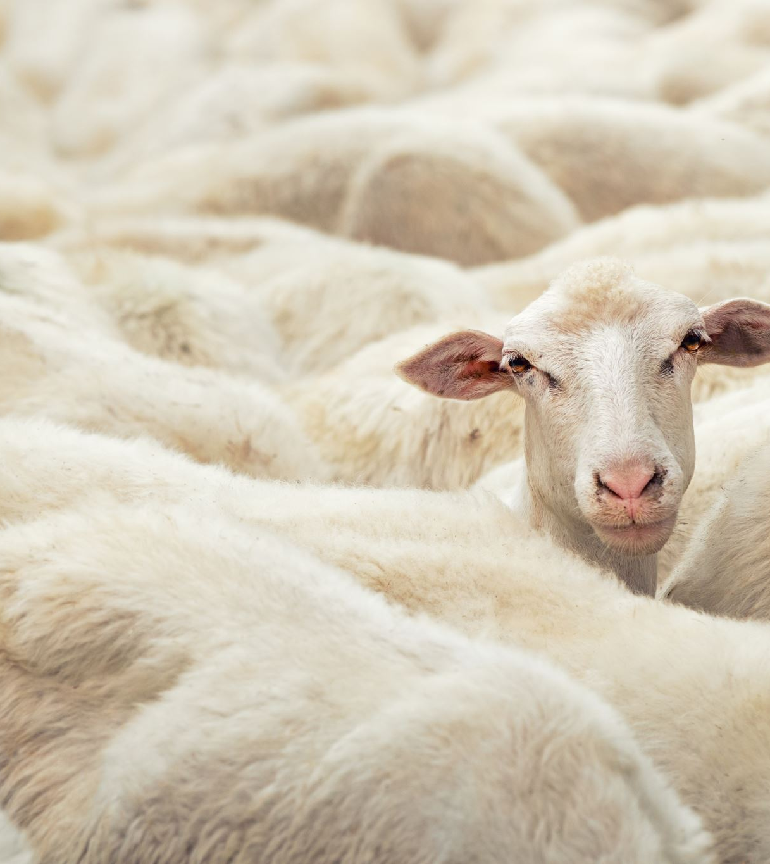
It will be hard for a believer not to get into heaven when Jesus is watching over us as His sheep!

Slide 30
IF we are
Focused on
Jesus

Slide 31
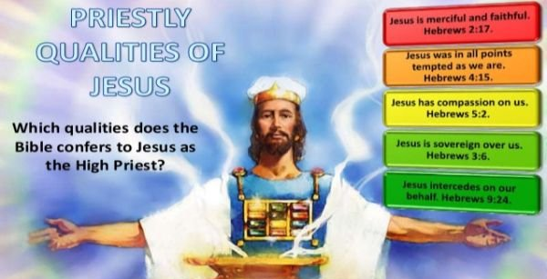
This Photo by Unknown Author is licensed under CC BY-SA

